Slide 1
Text Classification with Large Language Models
Detecting Machine-Generated Texts
A presentation on developing large language models (LLMs) for classifying and detecting texts generated by AI
By Zhan Yu, Wenkai Gong, Zachary Kong, Fengzhou Pan and Junyu Ren
Notes:
Entered text
\subsection{Text Representation}
\subsubsection{Static Methods}
Text representation methods play a crucial role in text mining and natural language processing tasks by converting textual data into numerical vectors, facilitating computational analysis and machine learning algorithms. Among the static methods utilized for text representation, word embeddings generated by techniques like word2vec and GloVe have garnered significant attention for their ability to capture semantic relationships between words in a continuous vector space.
\textbf{Word2Vec}, introduced by Mikolov et al. (2013), is a popular word embedding technique that learns distributed representations of words based on their contextual usage in a corpus. The model operates on the principle of predicting the surrounding words given a target word (Skip-gram), or predicting the target word given its context (Continuous Bag of Words, CBOW). By leveraging large text corpora, word2vec efficiently captures semantic similarities and relationships between words, enabling downstream tasks such as text classification and clustering to operate in a semantically meaningful space.
\textbf{GloVe}, proposed by Pennington et al. (2014), is another widely adopted word embedding method that combines global matrix factorization with local context window methods. Unlike word2vec, which relies solely on local context, GloVe incorporates global co-occurrence statistics to derive word embeddings. By representing words as vectors based on the probabilities of their co-occurrence with other words in the corpus, GloVe captures not only syntactic but also semantic relationships between words, yielding embeddings that excel in tasks requiring nuanced understanding of word semantics.

Slide 2
Addressing the Challenges of Large Language Models
The Rise of Large Language Models
The Need for Algorithms
Large language models (LLMs) are gaining popularity in various applications.
Powerful
Hard to differentiate between human-written ones
Utilizing advanced algorithms and models for detecting LLM-generated texts

Slide 3
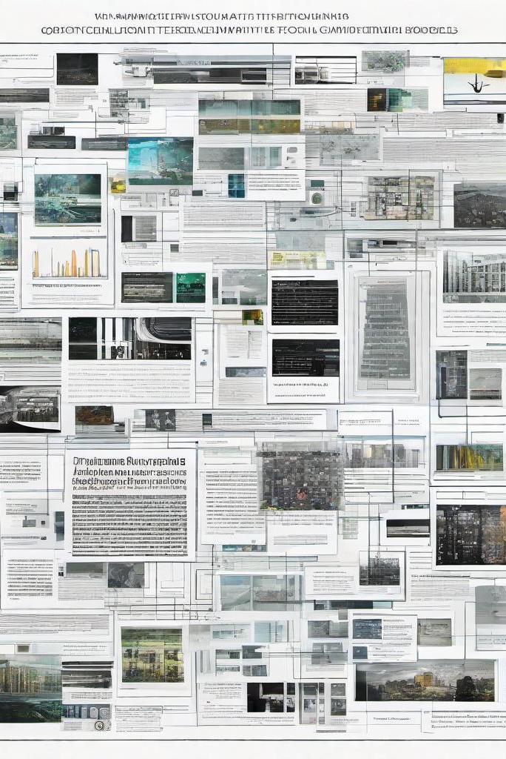
Project Objectives
Experimenting machine learning models with different embeddings
Evaluate their performance selecting the best ones

Slide 4

Datasets
Kaggle dataset with human written and AI generated essays
60k
AI generated and human written wikipedia introductions
150k

Slide 5
Text Representation
Static & Dynamic Methods
Notes:
Entered text
\subsection{Text Representation}
\subsubsection{Static Methods}
Text representation methods play a crucial role in text mining and natural language processing tasks by converting textual data into numerical vectors, facilitating computational analysis and machine learning algorithms. Among the static methods utilized for text representation, word embeddings generated by techniques like word2vec and GloVe have garnered significant attention for their ability to capture semantic relationships between words in a continuous vector space.
\textbf{Word2Vec}, introduced by Mikolov et al. (2013), is a popular word embedding technique that learns distributed representations of words based on their contextual usage in a corpus. The model operates on the principle of predicting the surrounding words given a target word (Skip-gram), or predicting the target word given its context (Continuous Bag of Words, CBOW). By leveraging large text corpora, word2vec efficiently captures semantic similarities and relationships between words, enabling downstream tasks such as text classification and clustering to operate in a semantically meaningful space.
\textbf{GloVe}, proposed by Pennington et al. (2014), is another widely adopted word embedding method that combines global matrix factorization with local context window methods. Unlike word2vec, which relies solely on local context, GloVe incorporates global co-occurrence statistics to derive word embeddings. By representing words as vectors based on the probabilities of their co-occurrence with other words in the corpus, GloVe captures not only syntactic but also semantic relationships between words, yielding embeddings that excel in tasks requiring nuanced understanding of word semantics.

Slide 6
Static Methods
Text Representation
Word2Vec: Converting words into vector representations capturing semantic meaning
Operates through two architectures: CBOW and Skip-Gram
GloVe: combines global matrix factorization with local context window methods
Incorporates global co-occurrence statistics to derive word embeddings

Slide 7
Dynamic Methods
Text Representation
BERT (Developed by Google in 2018, pioneering the use of bidirectional training in language models)
DistilBERT(Developed to provide a lighter, faster version of BERT that retains 97% of its language understanding capabilities while being 40% smaller and 60% faster.)
DEBERTa(Introduced by Microsoft in 2020, it enhances BERT and RoBERTa models with two key improvements: disentangled attention and an enhanced mask decoder.)

Slide 8
Classification
Traditional Machine Learning & Deep Learning
Notes:
Entered text
\subsection{Text Representation}
\subsubsection{Static Methods}
Text representation methods play a crucial role in text mining and natural language processing tasks by converting textual data into numerical vectors, facilitating computational analysis and machine learning algorithms. Among the static methods utilized for text representation, word embeddings generated by techniques like word2vec and GloVe have garnered significant attention for their ability to capture semantic relationships between words in a continuous vector space.
\textbf{Word2Vec}, introduced by Mikolov et al. (2013), is a popular word embedding technique that learns distributed representations of words based on their contextual usage in a corpus. The model operates on the principle of predicting the surrounding words given a target word (Skip-gram), or predicting the target word given its context (Continuous Bag of Words, CBOW). By leveraging large text corpora, word2vec efficiently captures semantic similarities and relationships between words, enabling downstream tasks such as text classification and clustering to operate in a semantically meaningful space.
\textbf{GloVe}, proposed by Pennington et al. (2014), is another widely adopted word embedding method that combines global matrix factorization with local context window methods. Unlike word2vec, which relies solely on local context, GloVe incorporates global co-occurrence statistics to derive word embeddings. By representing words as vectors based on the probabilities of their co-occurrence with other words in the corpus, GloVe captures not only syntactic but also semantic relationships between words, yielding embeddings that excel in tasks requiring nuanced understanding of word semantics.

Slide 9
Models
Traditional ML
Deep Learning
Language Model
Logistic Regression
Random Forest
XGBoost
MLP
BERT
DeBERTa
DistilBERT

Slide 10

Results - Fixed Text Embeddings
Notes:
Entered text
\subsection{Text Representation}
\subsubsection{Static Methods}
Text representation methods play a crucial role in text mining and natural language processing tasks by converting textual data into numerical vectors, facilitating computational analysis and machine learning algorithms. Among the static methods utilized for text representation, word embeddings generated by techniques like word2vec and GloVe have garnered significant attention for their ability to capture semantic relationships between words in a continuous vector space.
\textbf{Word2Vec}, introduced by Mikolov et al. (2013), is a popular word embedding technique that learns distributed representations of words based on their contextual usage in a corpus. The model operates on the principle of predicting the surrounding words given a target word (Skip-gram), or predicting the target word given its context (Continuous Bag of Words, CBOW). By leveraging large text corpora, word2vec efficiently captures semantic similarities and relationships between words, enabling downstream tasks such as text classification and clustering to operate in a semantically meaningful space.
\textbf{GloVe}, proposed by Pennington et al. (2014), is another widely adopted word embedding method that combines global matrix factorization with local context window methods. Unlike word2vec, which relies solely on local context, GloVe incorporates global co-occurrence statistics to derive word embeddings. By representing words as vectors based on the probabilities of their co-occurrence with other words in the corpus, GloVe captures not only syntactic but also semantic relationships between words, yielding embeddings that excel in tasks requiring nuanced understanding of word semantics.

Slide 11
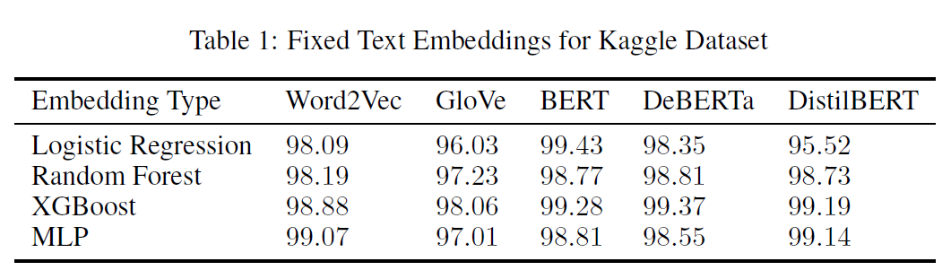
Kaggle Dataset(Small)
Accuracy > 95% for all models
Dynamic embeddings (from LM) have higher accuracy
Static Embeddings –> XGBoost & Random Forest > Logistic Regression
Dynamic Embeddings --> Logistic Regression > XGBoost & Random Forest
Notes:
Entered text
\subsection{Text Representation}
\subsubsection{Static Methods}
Text representation methods play a crucial role in text mining and natural language processing tasks by converting textual data into numerical vectors, facilitating computational analysis and machine learning algorithms. Among the static methods utilized for text representation, word embeddings generated by techniques like word2vec and GloVe have garnered significant attention for their ability to capture semantic relationships between words in a continuous vector space.
\textbf{Word2Vec}, introduced by Mikolov et al. (2013), is a popular word embedding technique that learns distributed representations of words based on their contextual usage in a corpus. The model operates on the principle of predicting the surrounding words given a target word (Skip-gram), or predicting the target word given its context (Continuous Bag of Words, CBOW). By leveraging large text corpora, word2vec efficiently captures semantic similarities and relationships between words, enabling downstream tasks such as text classification and clustering to operate in a semantically meaningful space.
\textbf{GloVe}, proposed by Pennington et al. (2014), is another widely adopted word embedding method that combines global matrix factorization with local context window methods. Unlike word2vec, which relies solely on local context, GloVe incorporates global co-occurrence statistics to derive word embeddings. By representing words as vectors based on the probabilities of their co-occurrence with other words in the corpus, GloVe captures not only syntactic but also semantic relationships between words, yielding embeddings that excel in tasks requiring nuanced understanding of word semantics.

Slide 12
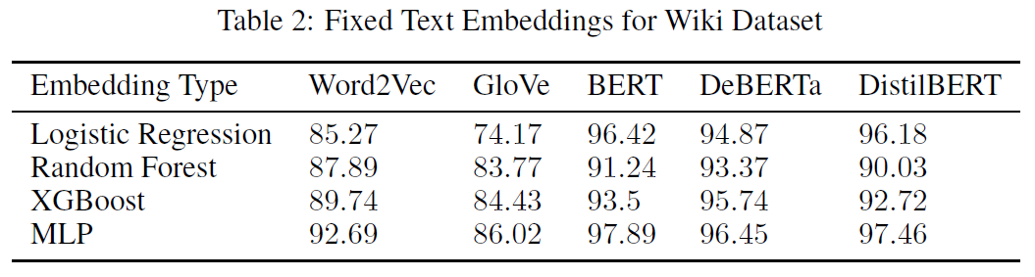
Wiki Dataset(Big)
Worse Performance Overall
Word2Vec (context-target) > GloVe (word co-occurrence matrices)
Dynamic Embeddings > Static Embeddings
MLP performed the best
Notes:
Entered text
\subsection{Text Representation}
\subsubsection{Static Methods}
Text representation methods play a crucial role in text mining and natural language processing tasks by converting textual data into numerical vectors, facilitating computational analysis and machine learning algorithms. Among the static methods utilized for text representation, word embeddings generated by techniques like word2vec and GloVe have garnered significant attention for their ability to capture semantic relationships between words in a continuous vector space.
\textbf{Word2Vec}, introduced by Mikolov et al. (2013), is a popular word embedding technique that learns distributed representations of words based on their contextual usage in a corpus. The model operates on the principle of predicting the surrounding words given a target word (Skip-gram), or predicting the target word given its context (Continuous Bag of Words, CBOW). By leveraging large text corpora, word2vec efficiently captures semantic similarities and relationships between words, enabling downstream tasks such as text classification and clustering to operate in a semantically meaningful space.
\textbf{GloVe}, proposed by Pennington et al. (2014), is another widely adopted word embedding method that combines global matrix factorization with local context window methods. Unlike word2vec, which relies solely on local context, GloVe incorporates global co-occurrence statistics to derive word embeddings. By representing words as vectors based on the probabilities of their co-occurrence with other words in the corpus, GloVe captures not only syntactic but also semantic relationships between words, yielding embeddings that excel in tasks requiring nuanced understanding of word semantics.

Slide 13

Results - Fine-tuning Language Model
Notes:
Entered text
\subsection{Text Representation}
\subsubsection{Static Methods}
Text representation methods play a crucial role in text mining and natural language processing tasks by converting textual data into numerical vectors, facilitating computational analysis and machine learning algorithms. Among the static methods utilized for text representation, word embeddings generated by techniques like word2vec and GloVe have garnered significant attention for their ability to capture semantic relationships between words in a continuous vector space.
\textbf{Word2Vec}, introduced by Mikolov et al. (2013), is a popular word embedding technique that learns distributed representations of words based on their contextual usage in a corpus. The model operates on the principle of predicting the surrounding words given a target word (Skip-gram), or predicting the target word given its context (Continuous Bag of Words, CBOW). By leveraging large text corpora, word2vec efficiently captures semantic similarities and relationships between words, enabling downstream tasks such as text classification and clustering to operate in a semantically meaningful space.
\textbf{GloVe}, proposed by Pennington et al. (2014), is another widely adopted word embedding method that combines global matrix factorization with local context window methods. Unlike word2vec, which relies solely on local context, GloVe incorporates global co-occurrence statistics to derive word embeddings. By representing words as vectors based on the probabilities of their co-occurrence with other words in the corpus, GloVe captures not only syntactic but also semantic relationships between words, yielding embeddings that excel in tasks requiring nuanced understanding of word semantics.

Slide 14
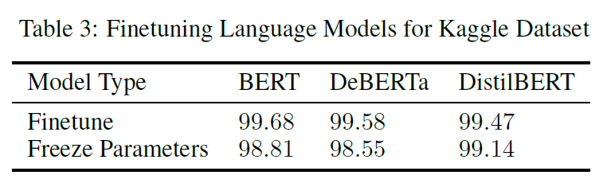
Kaggle Dataset(Small)
"Freeze Parameters" setting = MLP(fixed language model's embeddings)
Fine-tuning Process resulted in better accuracy
Fine-tuning not significant
Notes:
Entered text
\subsection{Text Representation}
\subsubsection{Static Methods}
Text representation methods play a crucial role in text mining and natural language processing tasks by converting textual data into numerical vectors, facilitating computational analysis and machine learning algorithms. Among the static methods utilized for text representation, word embeddings generated by techniques like word2vec and GloVe have garnered significant attention for their ability to capture semantic relationships between words in a continuous vector space.
\textbf{Word2Vec}, introduced by Mikolov et al. (2013), is a popular word embedding technique that learns distributed representations of words based on their contextual usage in a corpus. The model operates on the principle of predicting the surrounding words given a target word (Skip-gram), or predicting the target word given its context (Continuous Bag of Words, CBOW). By leveraging large text corpora, word2vec efficiently captures semantic similarities and relationships between words, enabling downstream tasks such as text classification and clustering to operate in a semantically meaningful space.
\textbf{GloVe}, proposed by Pennington et al. (2014), is another widely adopted word embedding method that combines global matrix factorization with local context window methods. Unlike word2vec, which relies solely on local context, GloVe incorporates global co-occurrence statistics to derive word embeddings. By representing words as vectors based on the probabilities of their co-occurrence with other words in the corpus, GloVe captures not only syntactic but also semantic relationships between words, yielding embeddings that excel in tasks requiring nuanced understanding of word semantics.

Slide 15
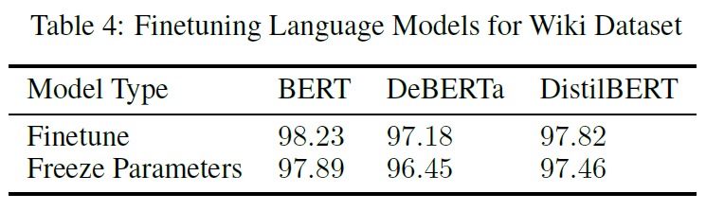
Wiki Dataset(Big)
Similar to Kaggle
Notes:
Entered text
\subsection{Text Representation}
\subsubsection{Static Methods}
Text representation methods play a crucial role in text mining and natural language processing tasks by converting textual data into numerical vectors, facilitating computational analysis and machine learning algorithms. Among the static methods utilized for text representation, word embeddings generated by techniques like word2vec and GloVe have garnered significant attention for their ability to capture semantic relationships between words in a continuous vector space.
\textbf{Word2Vec}, introduced by Mikolov et al. (2013), is a popular word embedding technique that learns distributed representations of words based on their contextual usage in a corpus. The model operates on the principle of predicting the surrounding words given a target word (Skip-gram), or predicting the target word given its context (Continuous Bag of Words, CBOW). By leveraging large text corpora, word2vec efficiently captures semantic similarities and relationships between words, enabling downstream tasks such as text classification and clustering to operate in a semantically meaningful space.
\textbf{GloVe}, proposed by Pennington et al. (2014), is another widely adopted word embedding method that combines global matrix factorization with local context window methods. Unlike word2vec, which relies solely on local context, GloVe incorporates global co-occurrence statistics to derive word embeddings. By representing words as vectors based on the probabilities of their co-occurrence with other words in the corpus, GloVe captures not only syntactic but also semantic relationships between words, yielding embeddings that excel in tasks requiring nuanced understanding of word semantics.

Slide 16
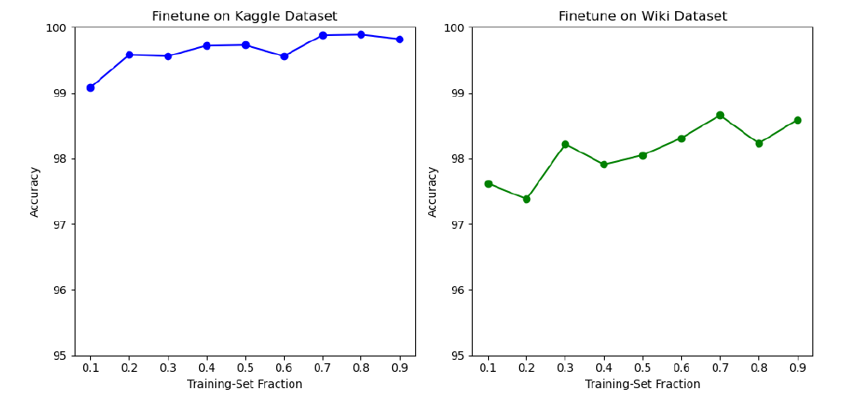
Sensitivity Study: Influence of Training-Set Fraction
Training Set Fraction –> Accuracy (small)
—> Embeddings(from LM) 👍 —> small fraction data enough
Notes:
Entered text
\subsection{Text Representation}
\subsubsection{Static Methods}
Text representation methods play a crucial role in text mining and natural language processing tasks by converting textual data into numerical vectors, facilitating computational analysis and machine learning algorithms. Among the static methods utilized for text representation, word embeddings generated by techniques like word2vec and GloVe have garnered significant attention for their ability to capture semantic relationships between words in a continuous vector space.
\textbf{Word2Vec}, introduced by Mikolov et al. (2013), is a popular word embedding technique that learns distributed representations of words based on their contextual usage in a corpus. The model operates on the principle of predicting the surrounding words given a target word (Skip-gram), or predicting the target word given its context (Continuous Bag of Words, CBOW). By leveraging large text corpora, word2vec efficiently captures semantic similarities and relationships between words, enabling downstream tasks such as text classification and clustering to operate in a semantically meaningful space.
\textbf{GloVe}, proposed by Pennington et al. (2014), is another widely adopted word embedding method that combines global matrix factorization with local context window methods. Unlike word2vec, which relies solely on local context, GloVe incorporates global co-occurrence statistics to derive word embeddings. By representing words as vectors based on the probabilities of their co-occurrence with other words in the corpus, GloVe captures not only syntactic but also semantic relationships between words, yielding embeddings that excel in tasks requiring nuanced understanding of word semantics.

Slide 17

Results - Embeddings Visualization
Notes:
Entered text
\subsection{Text Representation}
\subsubsection{Static Methods}
Text representation methods play a crucial role in text mining and natural language processing tasks by converting textual data into numerical vectors, facilitating computational analysis and machine learning algorithms. Among the static methods utilized for text representation, word embeddings generated by techniques like word2vec and GloVe have garnered significant attention for their ability to capture semantic relationships between words in a continuous vector space.
\textbf{Word2Vec}, introduced by Mikolov et al. (2013), is a popular word embedding technique that learns distributed representations of words based on their contextual usage in a corpus. The model operates on the principle of predicting the surrounding words given a target word (Skip-gram), or predicting the target word given its context (Continuous Bag of Words, CBOW). By leveraging large text corpora, word2vec efficiently captures semantic similarities and relationships between words, enabling downstream tasks such as text classification and clustering to operate in a semantically meaningful space.
\textbf{GloVe}, proposed by Pennington et al. (2014), is another widely adopted word embedding method that combines global matrix factorization with local context window methods. Unlike word2vec, which relies solely on local context, GloVe incorporates global co-occurrence statistics to derive word embeddings. By representing words as vectors based on the probabilities of their co-occurrence with other words in the corpus, GloVe captures not only syntactic but also semantic relationships between words, yielding embeddings that excel in tasks requiring nuanced understanding of word semantics.

Slide 18
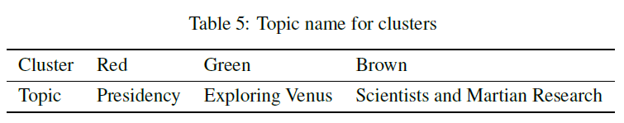
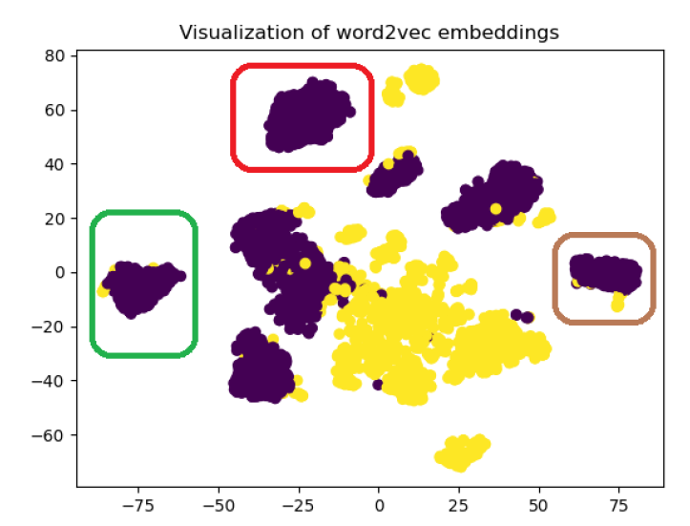
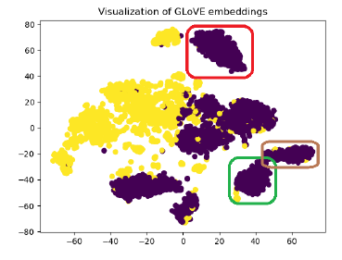
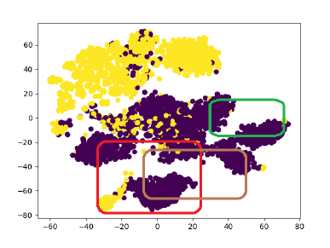
Notes:
Entered text
\subsection{Text Representation}
\subsubsection{Static Methods}
Text representation methods play a crucial role in text mining and natural language processing tasks by converting textual data into numerical vectors, facilitating computational analysis and machine learning algorithms. Among the static methods utilized for text representation, word embeddings generated by techniques like word2vec and GloVe have garnered significant attention for their ability to capture semantic relationships between words in a continuous vector space.
\textbf{Word2Vec}, introduced by Mikolov et al. (2013), is a popular word embedding technique that learns distributed representations of words based on their contextual usage in a corpus. The model operates on the principle of predicting the surrounding words given a target word (Skip-gram), or predicting the target word given its context (Continuous Bag of Words, CBOW). By leveraging large text corpora, word2vec efficiently captures semantic similarities and relationships between words, enabling downstream tasks such as text classification and clustering to operate in a semantically meaningful space.
\textbf{GloVe}, proposed by Pennington et al. (2014), is another widely adopted word embedding method that combines global matrix factorization with local context window methods. Unlike word2vec, which relies solely on local context, GloVe incorporates global co-occurrence statistics to derive word embeddings. By representing words as vectors based on the probabilities of their co-occurrence with other words in the corpus, GloVe captures not only syntactic but also semantic relationships between words, yielding embeddings that excel in tasks requiring nuanced understanding of word semantics.

Slide 19

Findings
Embedding Performance(TSNE used)
Word2vec, GLoVe, BERT –> Clear Split
BERT: Linear Separable Representations
-> Best Result👍
Case Study: Word2Vec form tight node cluster
Clusters form explicit topics
Word2vec & GLoVe > BERT
Notes:
Entered text
\subsection{Text Representation}
\subsubsection{Static Methods}
Text representation methods play a crucial role in text mining and natural language processing tasks by converting textual data into numerical vectors, facilitating computational analysis and machine learning algorithms. Among the static methods utilized for text representation, word embeddings generated by techniques like word2vec and GloVe have garnered significant attention for their ability to capture semantic relationships between words in a continuous vector space.
\textbf{Word2Vec}, introduced by Mikolov et al. (2013), is a popular word embedding technique that learns distributed representations of words based on their contextual usage in a corpus. The model operates on the principle of predicting the surrounding words given a target word (Skip-gram), or predicting the target word given its context (Continuous Bag of Words, CBOW). By leveraging large text corpora, word2vec efficiently captures semantic similarities and relationships between words, enabling downstream tasks such as text classification and clustering to operate in a semantically meaningful space.
\textbf{GloVe}, proposed by Pennington et al. (2014), is another widely adopted word embedding method that combines global matrix factorization with local context window methods. Unlike word2vec, which relies solely on local context, GloVe incorporates global co-occurrence statistics to derive word embeddings. By representing words as vectors based on the probabilities of their co-occurrence with other words in the corpus, GloVe captures not only syntactic but also semantic relationships between words, yielding embeddings that excel in tasks requiring nuanced understanding of word semantics.

Slide 20

Conclusion
Text Embeddings
Word2vec
GLoVe
BERT-like
Machine Learning
Logistic Regression
XGBoost
Random Forest
Deep Learning
MLP
BERT-like + Vanilla MLP
Word2vec & GLoVe (× Load Big Models)
Fine Tuning(Long Time) in Complicated Task

Slide 21
Thank You!
Notes:
Entered text
\subsection{Text Representation}
\subsubsection{Static Methods}
Text representation methods play a crucial role in text mining and natural language processing tasks by converting textual data into numerical vectors, facilitating computational analysis and machine learning algorithms. Among the static methods utilized for text representation, word embeddings generated by techniques like word2vec and GloVe have garnered significant attention for their ability to capture semantic relationships between words in a continuous vector space.
\textbf{Word2Vec}, introduced by Mikolov et al. (2013), is a popular word embedding technique that learns distributed representations of words based on their contextual usage in a corpus. The model operates on the principle of predicting the surrounding words given a target word (Skip-gram), or predicting the target word given its context (Continuous Bag of Words, CBOW). By leveraging large text corpora, word2vec efficiently captures semantic similarities and relationships between words, enabling downstream tasks such as text classification and clustering to operate in a semantically meaningful space.
\textbf{GloVe}, proposed by Pennington et al. (2014), is another widely adopted word embedding method that combines global matrix factorization with local context window methods. Unlike word2vec, which relies solely on local context, GloVe incorporates global co-occurrence statistics to derive word embeddings. By representing words as vectors based on the probabilities of their co-occurrence with other words in the corpus, GloVe captures not only syntactic but also semantic relationships between words, yielding embeddings that excel in tasks requiring nuanced understanding of word semantics.

